Slide 1
Kinematics and Dynamics of Robots
Spring Semester 2021
Lecturer: Yoav Golan

Slide 2
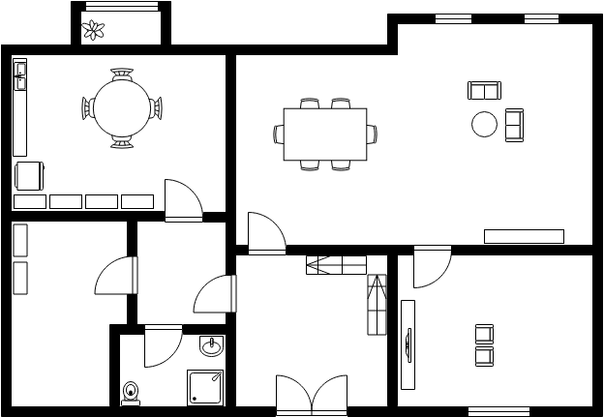
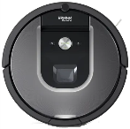
Where is the robot?

Slide 3
Reference Frames

Slide 4
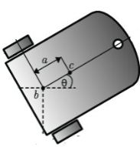
Reference Frames

Slide 5
Our Goal
Notes:
RoboDK here

Slide 6
Reference Frames
How do we describe one reference frame relative to another?
y2
x2
y1
P
x1

Slide 7
Easy problem
y_{B}
x_{B}
y_{A}
P
x_{A}
^{A}{B} = (30,20)
^{B}P = (15,-10)
^{A}P = ?

Slide 8
Easy problem
y_{B}
x_{B}
^{A}{B} = (30,20)
y_{A}
^{B}P = (15,-10)
P
x_{A}
^{A}P = ^{A}{B}+ ^{B}P=(30,20)+(15,-10)=(45,10)

Slide 9
Harder - Rotation
y_{B}
y_{A}
x_{B}
x_{A}

Slide 10
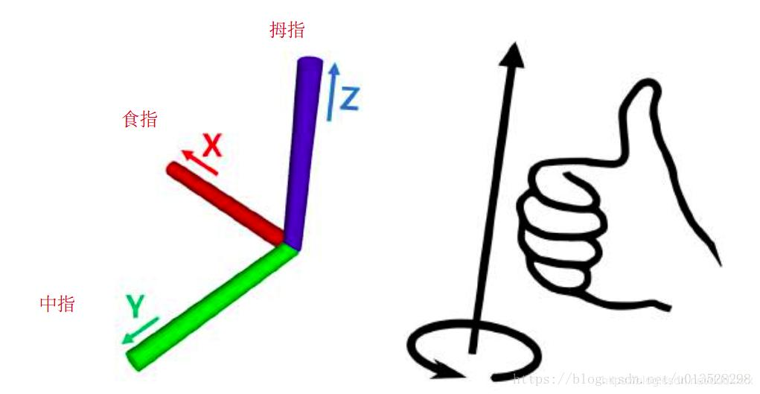
Right Hand Rule

Slide 11
Elementary Rotation Matrices

Slide 12
Class Problem #1
P
y_{B}
x_{B}
y_{A}
20^{O}
x_{A}
^{B}P = (30,25); ^{A}{B} = (50,30); ^{A}P =?

Slide 13
Class Problem #2
y_{B}
P
y_{A}
x_{B}
20^{O}
y_{W}
12^{O}
x_{A}
x_{W}
^{B}P = (30,25); ^{A}{B} = (50,30); ^{W}{A} = (90,70); ^{W}P =?

Slide 14
Class Problem #2
y_{B}
P
y_{A}
x_{B}
20^{O}
y_{W}
12^{O}
x_{A}
x_{W}

Slide 15
Perhaps a better way
y₄
x₄
y₃
P
y₂
x₃
L₃
θ₂
L₂
θ₃
y₀
x₂
L₁
y₁
x₁
θ₁
x₀

Slide 16
Forward Kinematics
P₂
P₁=?
P₂=?
L₂
θ₂
y₀
P₁
L₁
θ₁
x₀

Slide 17
Alternative Way
y₄
x₄
y₂
P₂
P₁=?
P₂=?
y₃
L₂
θ₂
x₂
y₁
x₃
y₀
P₁
L₁
x₁
θ₁
x₀
P₀

Slide 18
Alternative Way
y₄
P₁=?
P₂=?
x₄
y₂
P₂
y₃
L₂
θ₂
x₂
y₁
x₃
y₀
P₁
L₁
x₁
θ₁
x₀
P₀

Slide 19
Alternative Way
y₄
P₁=?
P₂=?
x₄
y₂
P₂
y₃
L₂
θ₂
x₂
y₁
x₃
y₀
P₁
L₁
x₁
θ₁
x₀
P₀

Slide 20
Alternative Way
y₄
P₁=?
P₂=?
x₄
y₂
P₂
y₃
L₂
θ₂
x₂
y₁
x₃
y₀
P₁
L₁
x₁
θ₁
x₀
P₀

Slide 21
Class Problem #3
P
L₃
θ₂
L₂
θ₃
y₀
L₁
θ₁=30º θ₂=15º θ₃=35º
L₁=400mm L₂=300mm L₃=200mm
θ₁
x₀
P=?

Slide 22
Forward Kinematics
P
L₃
θ₂
L₂
θ₃
y₀
L₁
θ₁
x₀
P(θ₁, θ₂, θ₃)=?

